Slide 1
Zybo Autonomous Car
Cătălin-Constantin Bitire
Marin-Mircea Cojocaru
Andrei Ionașcu

Slide 2
Motivation
Introduction
Design
Control Algorithm
Live Demo

Slide 3
1. Motivation

Slide 4
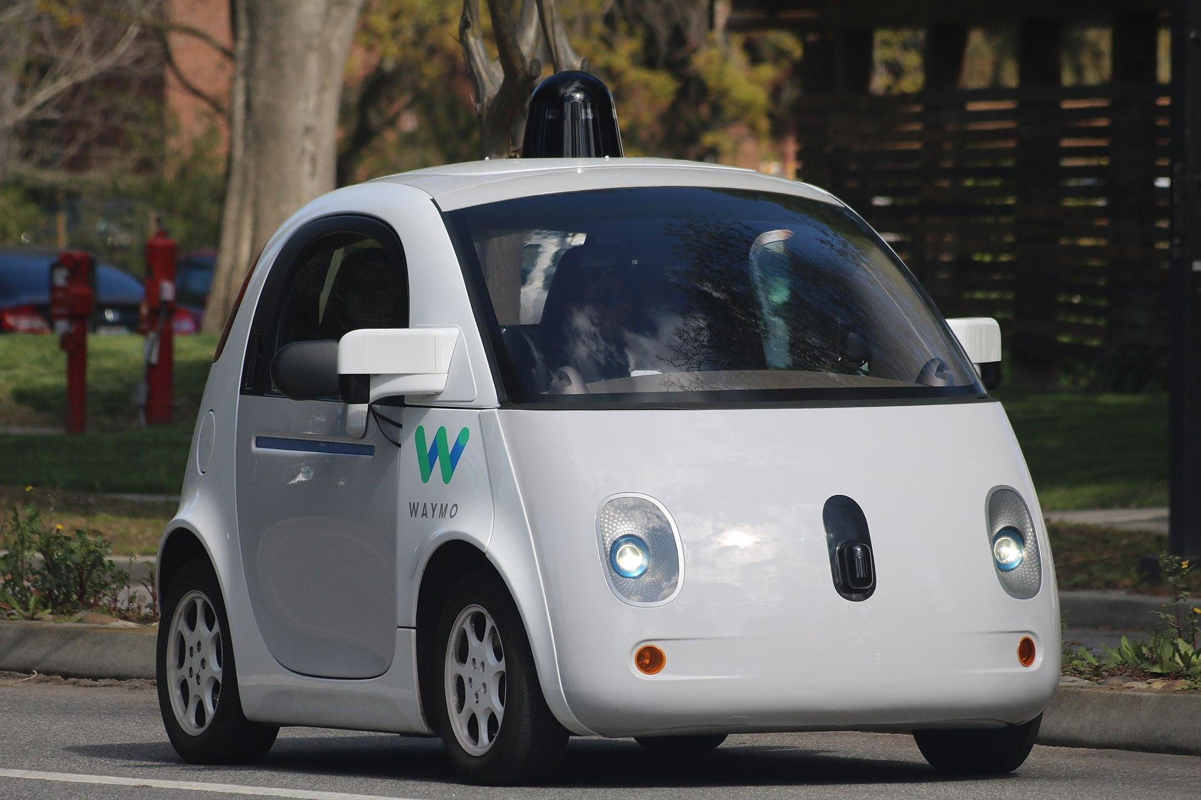
Why this project?
Nowadays the subject of automated systems is very popular. It is possible that autonomous vehicles will not be the solution to today’s traffic and pollution but it’s worth a try.
Having in mind the possible benefits and adding our passion for cutting edge technology this feels like quite a good project.

Slide 5
2. Introduction

Slide 6
Abstract
An OpenCV and Embedded Linux powered car with the following key-features:
Drive between lane lines
Stop at obstacles
Detect road signs
Execute smart commands from RFID cards
Navigate crossroads

Slide 7
Objectives
What we wanted: “A combination of complex components and an array of sensors that together result in a working version of a self-driving car.”
What we got: “An introductive and intuitive platform for future autonomous car developments and implementations with the Zybo Z7-20.”

Slide 8
3. Design

Slide 9
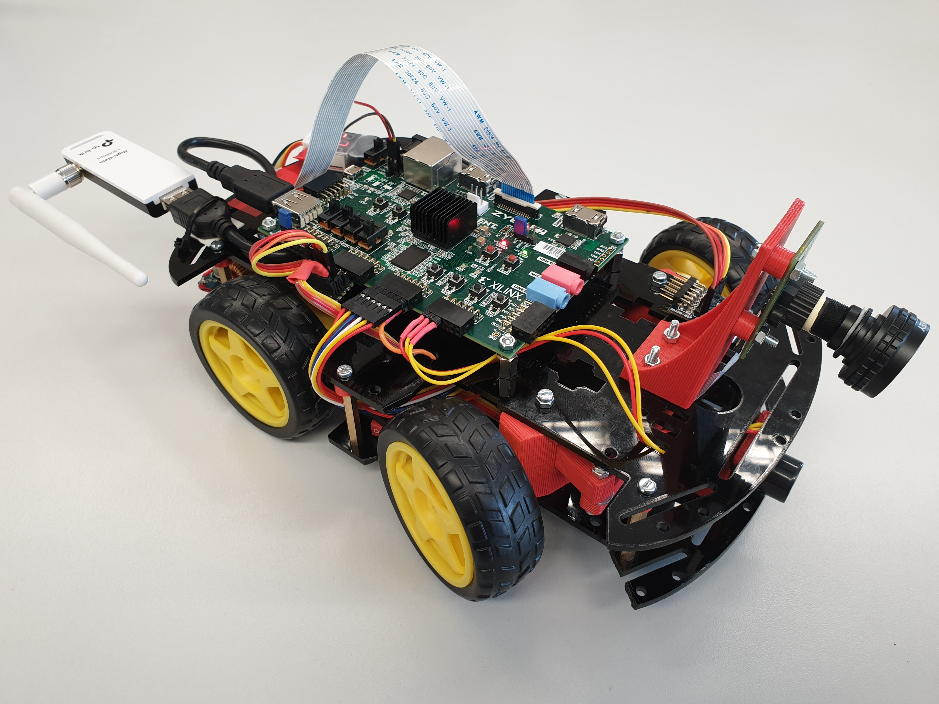
Physical Car Design
The car’s appearance is intended to look like a normal car without bodywork.
The exposed Zybo Z7-20 and other components are there for easy access in a development environment.

Slide 10
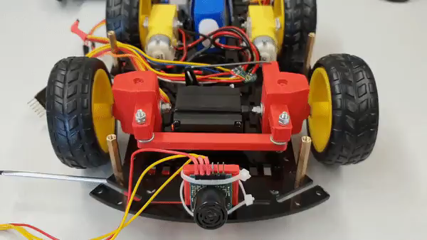
Physical Car Design
The front wheels move like on a normal car, steering left to right, instead of the classic tank style, all wheel drive, system present on most development platforms available today.

Slide 11
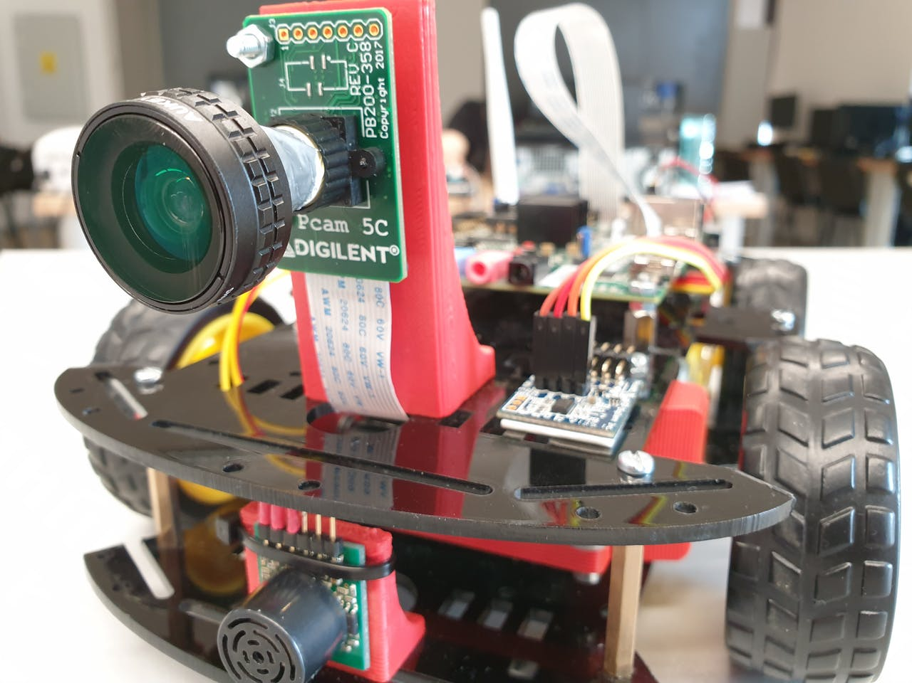
Physical Car Design
Our camera is mounted where the main camera would be on a normal car with camera assistance, that is in front of the car, without sticking out too much.
The sonar is mounted in the front bumper spot, to prevent collisions.

Slide 12
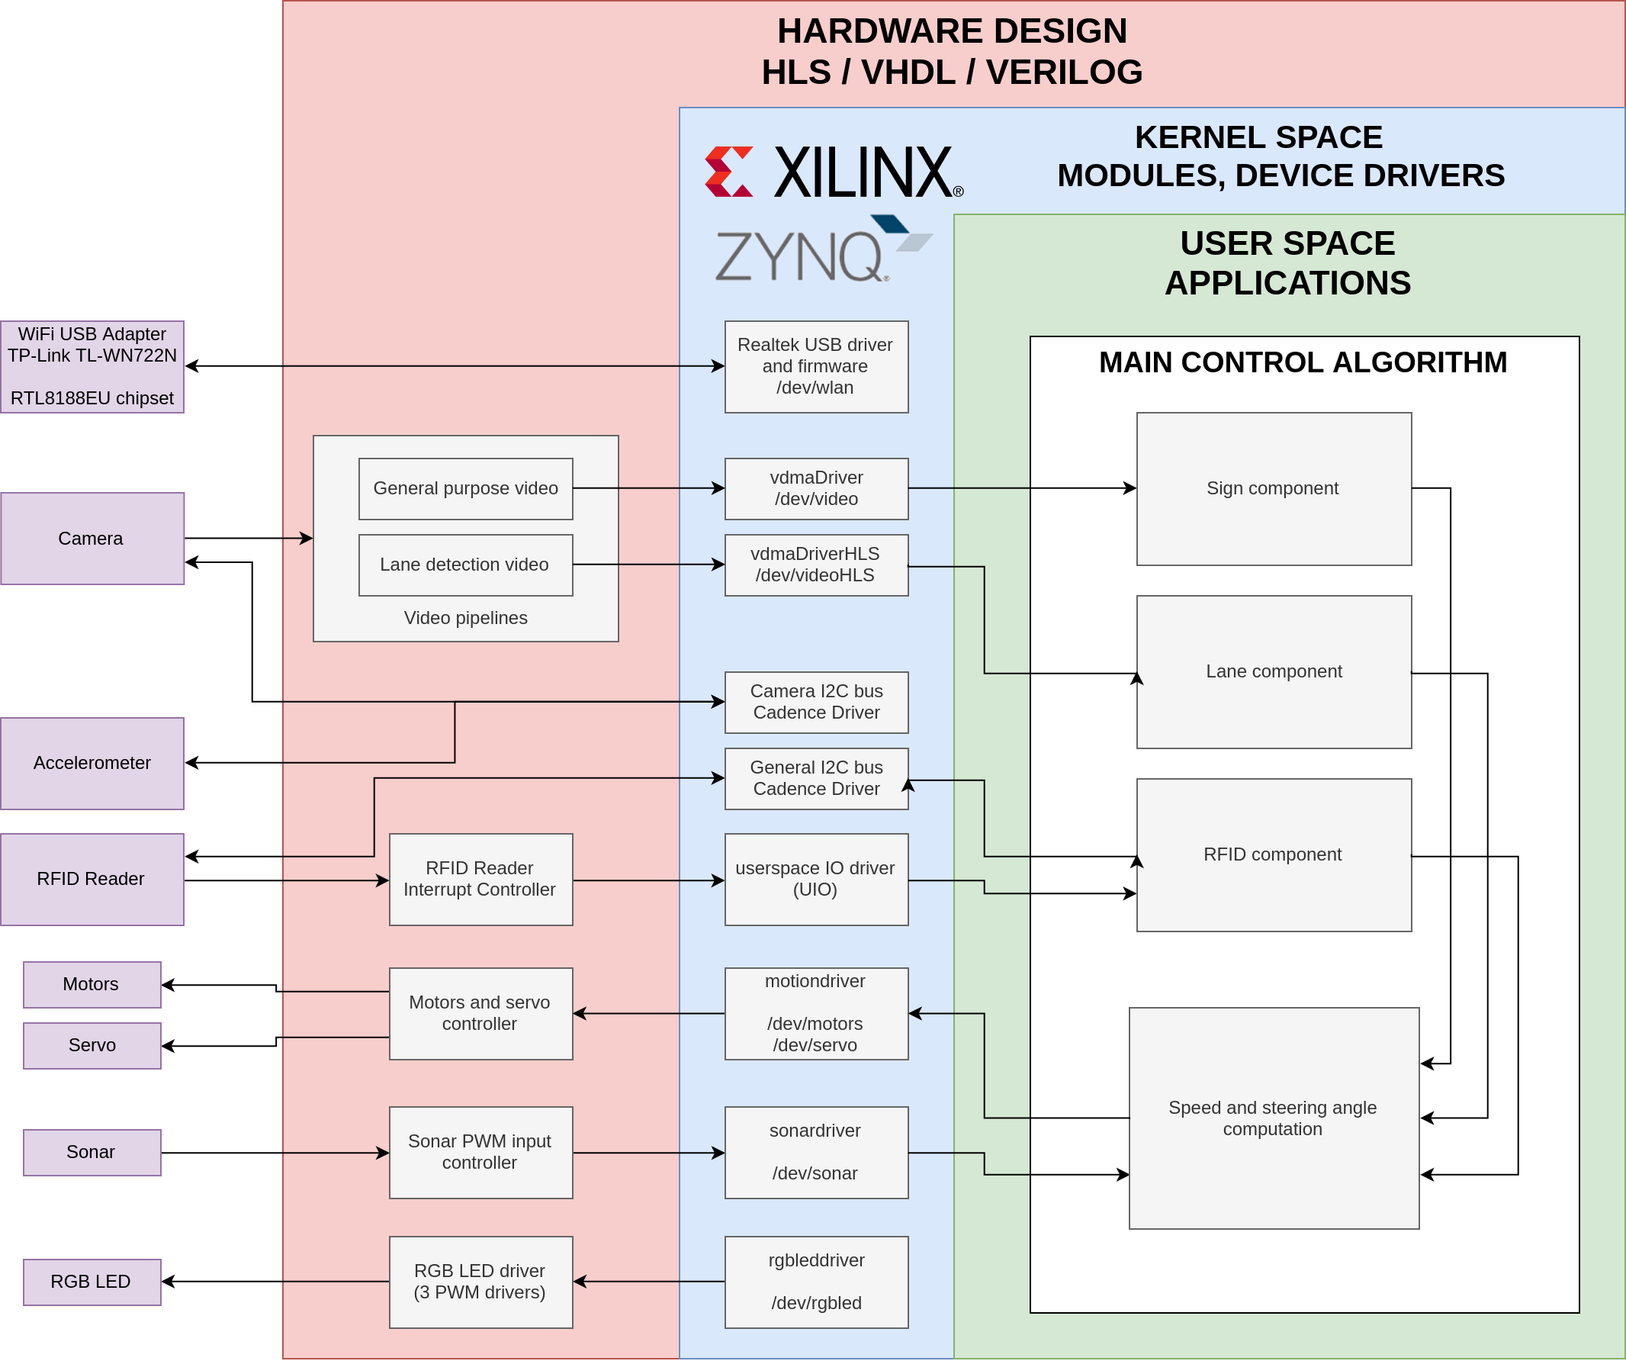
Hardware design
This slide explains how every component is linked through the Zybo Z7-20 board.

Slide 13
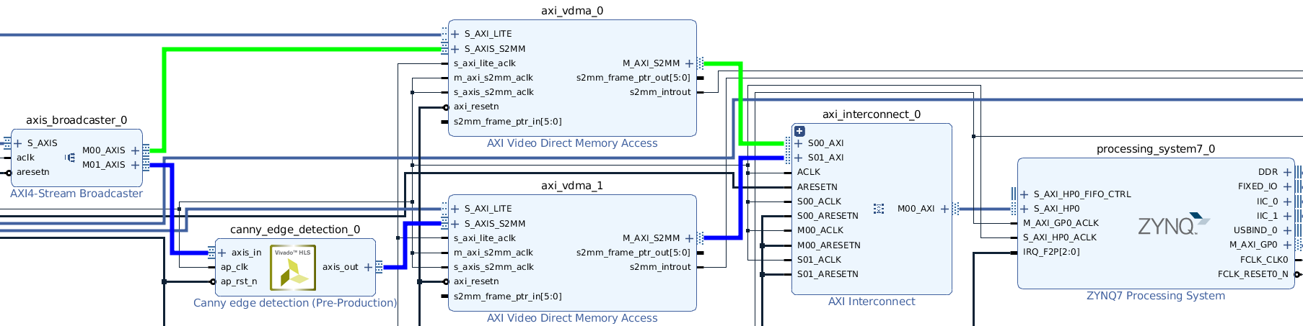
Hardware design
There are two video pipelines each useful to one control component.
The hardware accelerated one greatly increases the processing speed, Canny edge detection being quite taxing for the general purpose CPU.

Slide 14
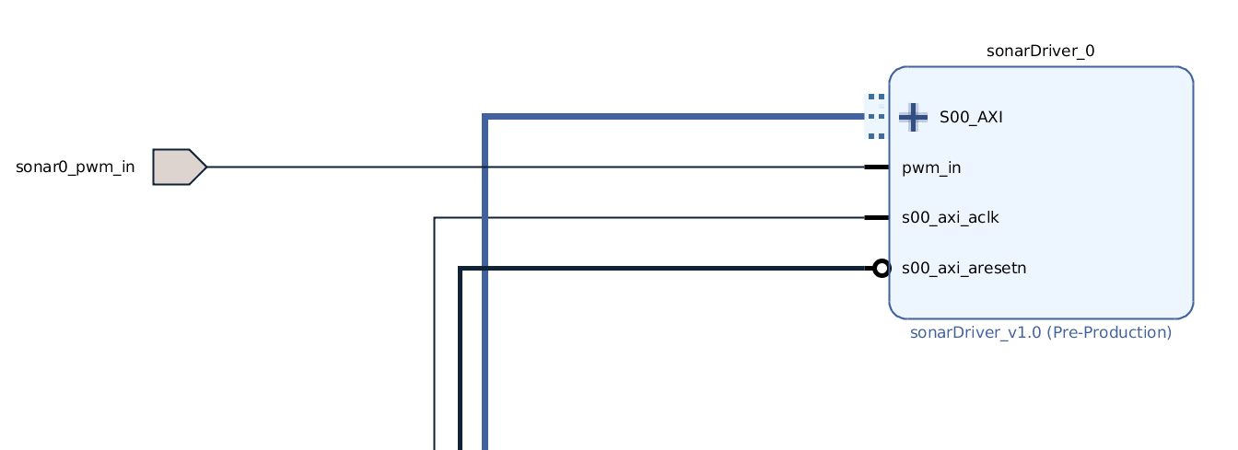
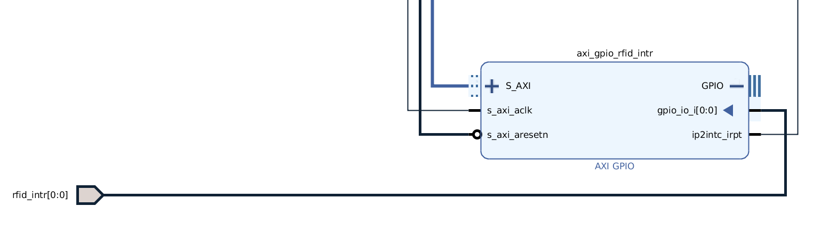
Hardware design
The sensor data acquisition part handels the sonar, RFID and accelerometer.
The sonar works using PWM while the other two are I2C enabled.

Slide 15
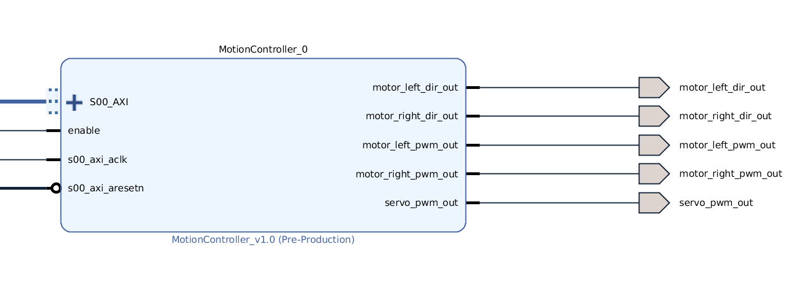
Hardware design
The motors and steering component are based on 3 PWM drivers. Two of them control the left and right traction motors leaving the last PWM signal to control the steering part of the car with the servo motor.

Slide 16
4. Control Algorithm

Slide 17
Car Control
This part of the program combines all the data received from the camera and the sensors and issues commands to the car’s motors to safely and correctly navigate a given track.

Slide 18
Car Control
This takes data from the following components:
Camera
Sonar
RFID scanner
Accelerometer
With this data it computes the parameters for the car to stay between the lines, update its speed or even stop it in emergency situations.

Slide 19
Car Control
The values are updated at each iteration of the control loop and with our relatively high fps there are a lot of little adjustments in speed and steering angle on a given track portion.
This translates into a smooth motion of the car without any significant jitters.

Slide 20
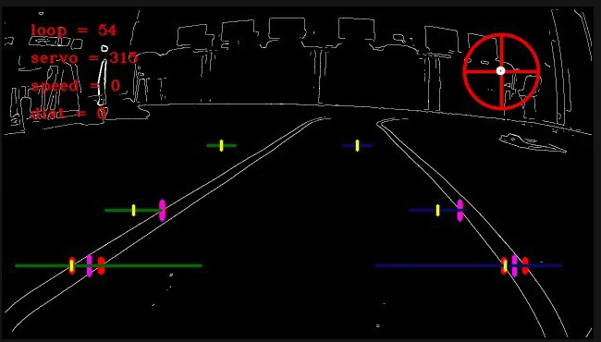

Slide 21
Sign Detection
This part is responsible of detecting and checking for road signs notifying the control part about the encountered signs.

Slide 22
Sign Detection
For an autonomous car today sign detection is a critical component, as this is the only reliable system of communicating the roads restrictions apart from lane lines to the self-driving system.

Slide 23
Sign Detection
Our approach was to demonstrate that we can achieve satisfying results on our platform with the possibility of expanding or even changing our approach to the detection technique.
The mechanism used to detect signs is a Haar Cascade Classifier, one of the simplest object detection procedures, it identifies signs correctly but maybe a deep learning method will be more successful.

Slide 24
Sign Detection
Perhaps in the future there will be a reliable API to interface self-driving cars and to transmit key commands that will replace road signs, but until then we cannot omit this aspect of reliable autonomous vehicles.

Slide 25
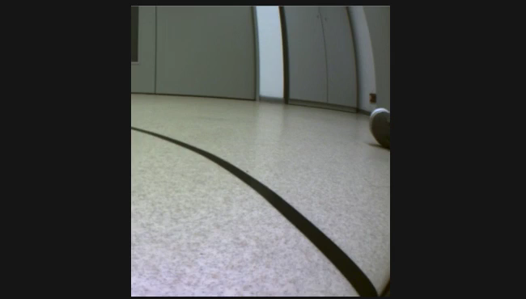

Slide 26
RFID Processing
This is the part used to translate information from RFID cards laid in the track to the control part.

Slide 27
RFID Processing
This is a better way to understand road constraints for an autonomous car.
The main advantage of this over signs is that the cards give a specific command, ready to be executed instead of an image that first needs to be decoded to get the relevant information out of it.

Slide 28
RFID Processing
By eliminating the “translation” from human to computer language we can save critical time with less processing power thus eliminating dangerous aspects of self-driving cars without any additional failsafes.
This was the motivation behind the use of RFID cards, the simulation of a more computer friendly way to deal with road restrictions.

Slide 29
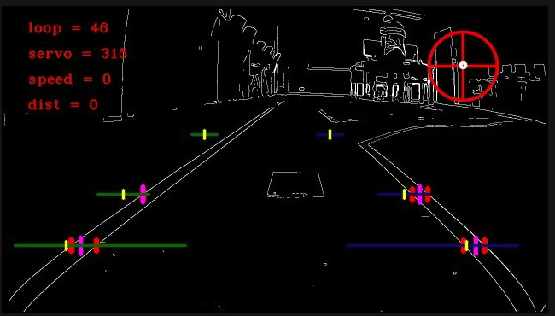

Slide 30
References
Linux Device Drivers, Third Edition by Jonathan Corbet, Alessandro Rubini, and Greg Kroah-Hartman
The Xilinx Forums
The Petalinux Tools ‘Bible’, UG1144 Petalinux Tools Reference Guide
OpenCV official documentation

Slide 31
Find us at
Cătălin - github.com/Catabit
Mircea - github.com/mirelonni
Andrei - github.com/ioascuandrei

Slide 32
5. Live Demo

